Slide 1
Evaluation of Style Advisor Performance
Subtitle: Comprehensive Analysis and Insights

Slide 2
Introduction
Introduction
The project aims to evaluate the performance of Style Advisors using a comprehensive set of criteria. The evaluation data covers various aspects such as store ambiance, first impressions, discovery of customer needs, trial experience, and overall customer service. The primary focus is on understanding how well Style Advisors are performing and identifying areas for improvement

Slide 3
Objectives
Performance Grading: Assign grades to each Style Advisor based on their Evaluation Score.
2. Pivot Table Analysis: Analyze average evaluation scores by zone to understand regional performance.
3. High Performer Identification: Determine which region has the highest percentage of high performers.
4. Visualization: Create visual representations of the data to highlight key trends and insights.
5. Presentation Report: Summarize findings and provide recommendations for management

Slide 4
Key Performance
Task-1
Performance Grading
Using the Evaluation Score, assign grades as follows:
High Performer: 90% - 100%
Average Performer: 70% - 89%
Low Performer: 50% - 69%
Bottom Performer: Below 50%

Slide 5
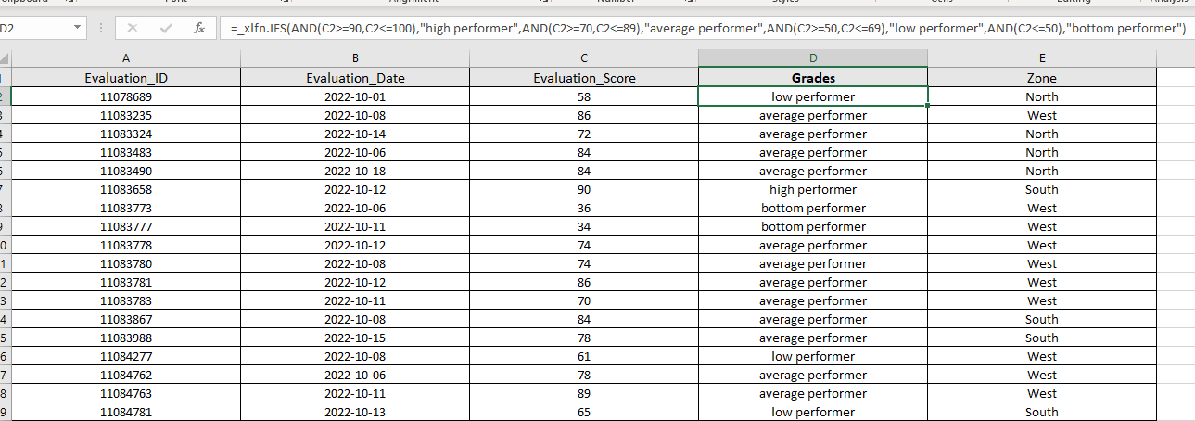
Assigning Grades Through performance
=IFS(AND(C2>=90,C2<=100),"high performer",AND(C2>=70,C2<=89),"average performer",AND(C2>=50,C2<=69),"low performer",AND(C2<=50),"bottom performer")

Slide 6
Task-2
Pivot Table Analysis
To create a pivot table that shows the average Evaluation Score by Zone:
1. Data Preparation: Ensure the data is clean and organized.
2. Create Pivot Table: Use Excel or Google Sheets to create a pivot table with "Zone" as the row label and average of "Evaluation Score" as the value.

Slide 7
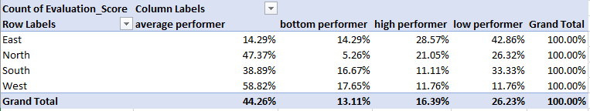
Steps to Find the Region with the Highest Percentage of High Performers :
Create a Pivot Table: Show counts of each performance grade by Zone.
2. Calculate Percentage: For each zone, divide the number of High Performers by the total number of evaluations.
Identify Region: Find the zone with the highest percentage of High Performers

Slide 8
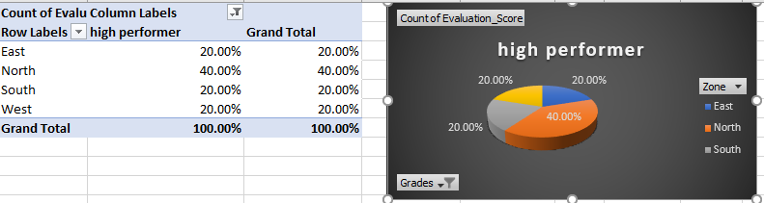
Task-3
Visualization
1. Average Evaluation Scores by Zone: Bar chart showing average scores for each zone.
2. Percentage of High Performers by Region: Pie chart showing the percentage of High Performers in each region.

Slide 9
3. Performance Distribution Over Time: Line graph showing trends in performance scores over time.
4. Performance Breakdown by Criteria: Heatmap showing average scores for various evaluation criteria.

Slide 10
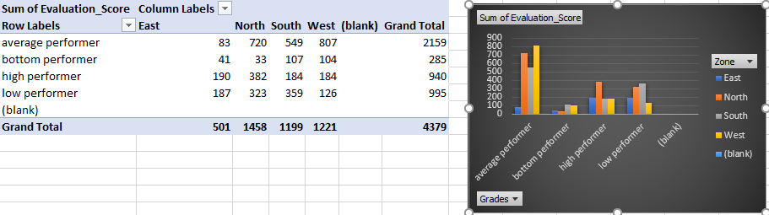
5. Comparison of High vs. Low Performers: Stacked bar chart comparing characteristics of High and Low Performers

Slide 11
Conclusion
Based on the analysis, the management team will gain insights into the effectiveness of Style Advisors across different regions. The visualizations will provide a clear picture of performance trends, high-performing regions, and areas requiring attention. Recommendations can be made to enhance overall performance based on the identified strengths and weaknesses.

Slide 12
Presented by : E Sweta Rao

